Slide 1
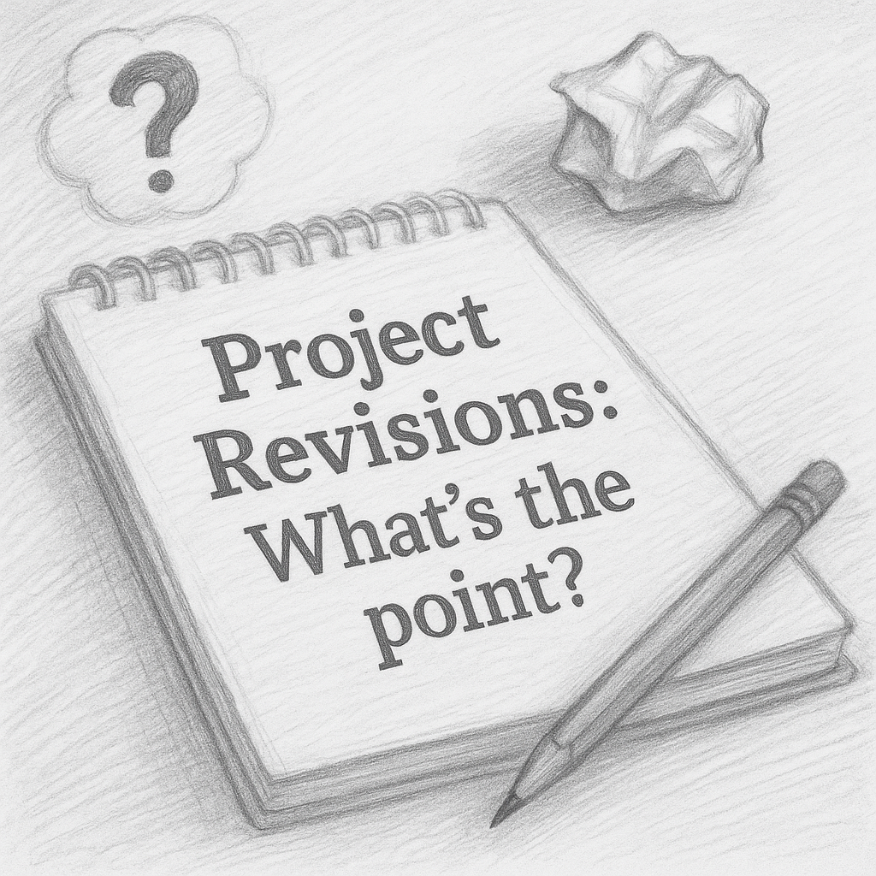

Slide 5
We critique the work, not the person.

Slide 6
Everyone struggles. That’s part of progress.

Slide 7
This is a place to make mistakes and learn.

Slide 8
Reworking something is a win, not a failure.

Slide 9
Learn from each other, not just from me.

Slide 10
We rise by lifting others.

Slide 11
Let’s start…

